Slide 1
International Contemporary Designers
These are the designers that have changed the way graphic design is seen in the contemporary world; the mavericks; the thinkers; those who have made a difference.

Slide 2
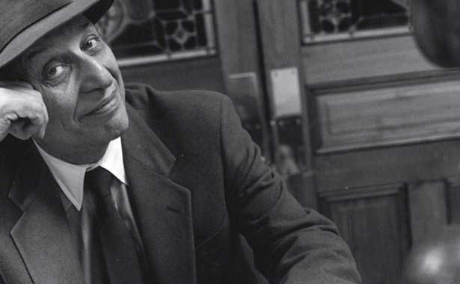
Milton Glaser
Milton Glaser is one of the world's most celebrated graphic designers. His most famous work is undoubtedly the logo he designed for New York to promote tourism in the city in 1977 (below).
Much copied, much used and much adored, the 'I love New York' logo is set in American Typewriter, a rounded slab serif.

Slide 3
"The most important thing in design, it seems to me, is the consequence of your action, and whether you're interested, fundamentally, in persuading people to do things that are in their interests," he told Computer Arts: learn more in this exclusive interview. He's also the subject of a 2008 documentary film Milton Glaser: To Inform and Delight.
His 'I Love New York' logo has been in use since 1977

Slide 4
Stefan Sagmeister
Born in Austria, New York-based graphic designer and typographer Stefan Sagmeister has had somewhat of a resurgence in the last year – mainly due to Sagmeister Inc becoming Sagmeister & Walsh after he made talented young designer Jessica Walsh partner. Announcing himself on the scene 20 years ago with a naked shot, the pair recently did the same thing.
But there's more to Sagmeister than nudity: his often conceptual, thought-provoking work has turned just as many heads as his PR: particularly his 'cutting' work for AIGA and his incredible album artwork for Lou Reed

Slide 5
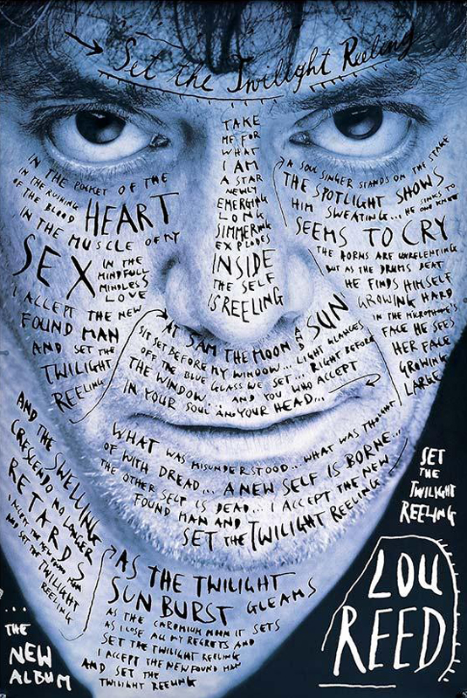
Stefan Sagmeister

Slide 6
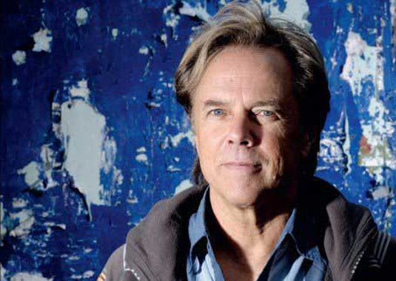
David Carson
Carson is best known for innovative magazine design and use of experimental typography, As art director of music and lifestyle magazine Ray Gun, David Carson became the most influential graphic designer of the 1990s.
His unconventional grunge typography style was a new era in design – something completely different to what had been before. An example of his genius? Using the Dingbat symbol font for what he thought a dull interview with Bryan Ferry.

Slide 7
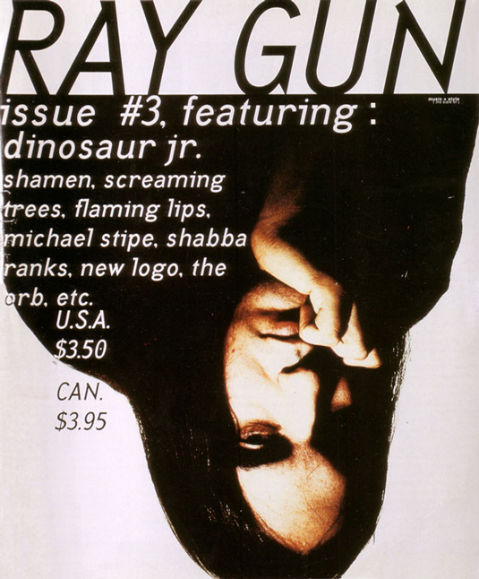
The first edition of his End of Print monograph, first published in 2000, sold 35,000 copies – and many many more since. It's essential reading for any graphic designer – new or established.
"What matters is that you have an intuitive design sense, listen to it and explore your uniqueness through your work,”.
"Create rules earned all the things in school I wasn't supposed to do, so I just did, and hat work for you and the type of work you're doing. I never ld still do, what makes sense to me."

Slide 8
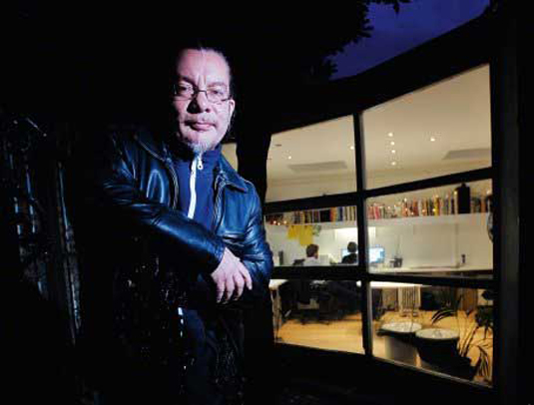
Neville Brody
English designer, typographer and art director Neville Brody shot to fame with his incredible art direction of cult UK magazine The Face between 1981 and 1986.
He's also well known for art-directing Arena magazine (1987-1990) and designing record covers for artists such as Cabaret Voltaire and Depeche Mode.
Brody is best known for art-editing influential UK magazine The Face during its 1980s heyday

Slide 9
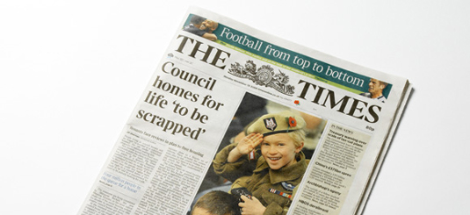
More recently, Brody founded Research Studios and redesigned The Times in November 2006 (with the creation of a new font Times Modern) and the BBC's website in September 2011.

Slide 10
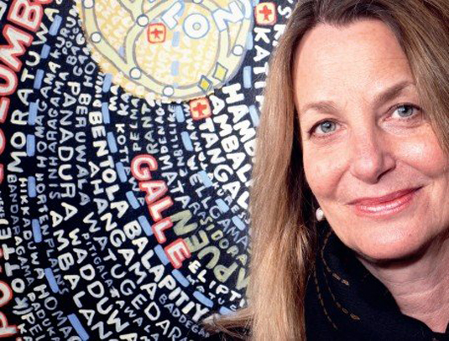
Paula Scher
Partner at Pentagram and almost certainly the most influential female graphic designer alive today, Paula Scher's branding and identity work for the likes of MOMA, New York City Ballet, Microsoft and NYC Transit is some of the finest examples of the genre you'll ever see.
Her recent work, creating a new logo for Microsoft Windows 8.
Her typographic maps are also sublime
Scher has been a design educator since 1992, teaching at the School of Visual Arts (SVA) in New York

